Slide 1
Setting Up Python and Developing a Simple Application
Set Up the Development Environment
Write Python Statements
Create a Python Application
Prevent Errors

Slide 2
Set Up the Development Environment
Topic A

Slide 3
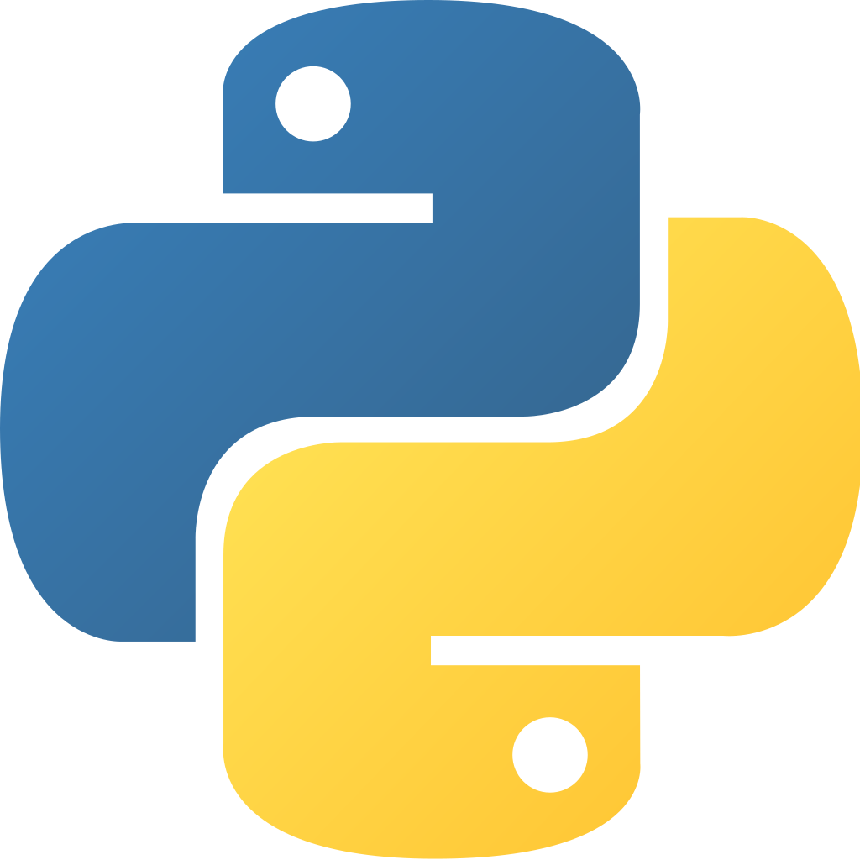
Programs Developed in Python
Types
Data analysis and forecasting tools
Artificial intelligence
Web apps
Video games
Audio/video apps
Mobile apps
Networking apps
Scientific/mathematical apps
Security utilities
Educational apps
Examples
Instagram
Spotify
Dropbox
PyCharm
Django
Blender
ERP5

Slide 4
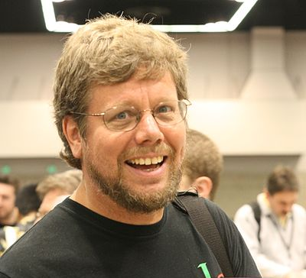
History of Python
Created by Guido van Rossum in the late 1980s.
Goals
Easy to read
Require minimal lines of code as compared to other languages
Early versions released over the next few years
Version 1.0 not released until January of 1994
Python 2
First major update to Python
Released in October 2000
Garbage collection, augmented assignment, list comprehension, Unicode strings, etc.
As of April 2020, most recent version of Python 2 is 2.7.18
Superseded by Python 3 but remains in use by some developers
Python 3
Most recent major version
Up to version 3.9.0 as of late 2020

Slide 5
Interpreters and Compilers
Compiler
Translates source code into code that can run on the computer
Translates code in advance, compiling it into a ready-to-run executable file
Benefits:
Tends to run faster than interpreter
Reveals major errors to the programmer when program is compiled
Interpreter
Translates source code into code that can run on the computer
Translates code just-in-time, interpreting the source code into executable code as the program runs
Benefits:
Generally easier to use than compiler
Deliverable is more “portable”
More convenient to perform quick updates

Slide 6
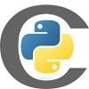
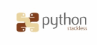

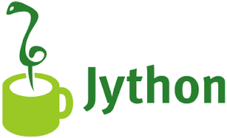
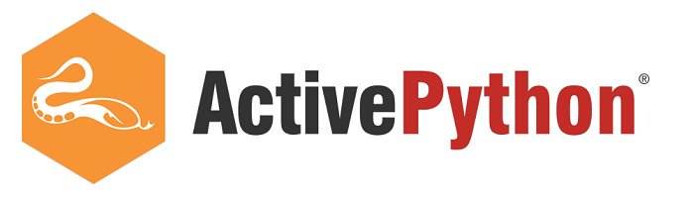

Python Implementations
6

Slide 7



CPython
Bytecode
Virtual machine
Python code
Program output
0 LOAD_NAME
3 LOAD_CONST
6 CALL_FUNCTION
9 PRINT_EXPR
12 LOAD_CONST
15 RETURN_VALUE+
print("Hello, world!")
Hello, world!

Slide 8
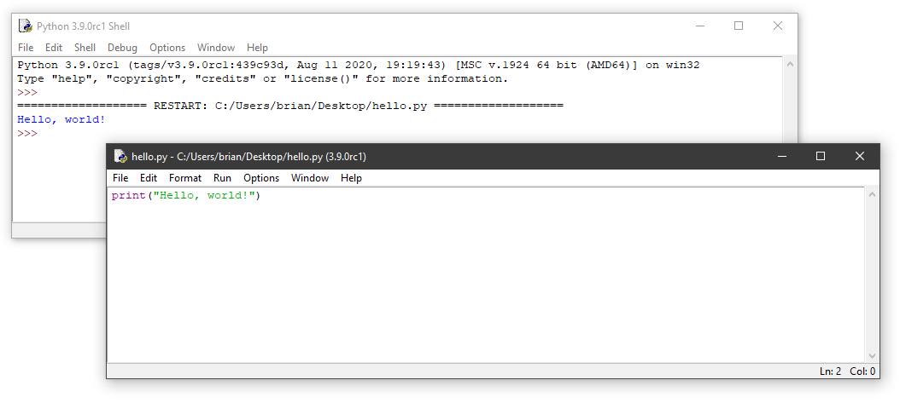
IDLE

Slide 9
Other Python IDEs
PyCharm
Jupyter Notebook
Python Tools for Visual Studio®
Komodo® IDE
Wing IDE
PyDev
Spyder

Slide 10
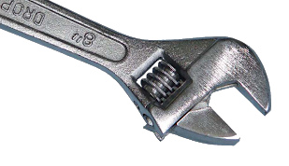

IDE Configuration
Choice in Python implementations
As a Python developer, you might have:
Programs written in various versions of Python
Multiple versions of Python installed on your development computer
Multiple IDEs and code editors
Python interpreters and IDEs
Are typically separate software products, installed separately
May need to be configured to work together

Slide 11

Python Projects
Can become large and complex, with multiple files
Are often stored in a project folder to keep things organized
IDEs such as PyCharm:
Enable you to automatically create a new folder when starting a project
May include support files that configure the programming project
Example: Which version of Python should be used to interpret project’s source code
Associating an interpreter with a project:
Enables your software development environment to know which Python interpreter to use
Is typically configured at the start of a new project
Identifies which version of the Python language is supported in your project
WordCount project

Slide 12

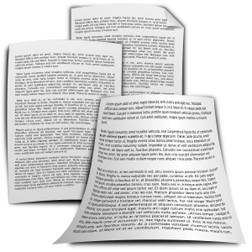

Activity: Running a Python Script
manuscript
Fuller & Ackerman (F&A) publishing firm:
Publishes a wide variety of books and other written materials in various formats.
Wants to use computer programs to analyze manuscripts submitted by authors.
Will eventually perform a wide range of automated analysis this way.
Has identified simple software requirements for a proof-of-concept application.
Wants the application to be developed in Python.
Has recently hired you as an application developer to perform this task.

Slide 13
Data Resources Used in WordCount
Word List
wordsEn.txt 100,000+
English words
aardvark
…
zymurgy
Common Words
Input File
33 common words “the”, “be”, “are”, “is”, …
Manuscript
+
-
50
50
the: 23
quick: 13
brown: 15
fox: 11
jumped: 9
over: 8
lazy: 7
…
After all manuscript words are counted, keep just the 50
most frequent
the: 23
brown: 15
quick: 13
fox: 11 …
the: 23
brown: 15
quick: 13
fox: 11,
Read all words in from the manuscript
The quick brown fox jumped over the lazy dog…
If a manuscript word appears in the word list, then count it.
Strip common words

Slide 14
The WordCount Program Flowchart
Start reading input
Start analyzing
Start reporting
1
Loop
Display results on screen
Get
manuscript file name from user
2
Get next word from manuscript words
Save to log?
Valid file?
Manuscript word in the word list?
no
no
no
yes
yes
yes
5
Save to log file and dated archive file
Read manuscript and make a list of all manuscript words
Increase count of this word
More words
to read
6
End of Loop
List files in the output folder
No more words to read
3
Done reading input
Only keep counts for the top 50 words
Done reporting
Strip common words?
no
yes
4
Strip common words from the top 50 list
Done analyzing

Slide 15
Activity: Setting Up the Python Development Environment
The Python 3.9.0 interpreter and the PyCharm IDE have both been installed on your computer.
Before you start developing any project, you need to configure the IDE with the directory paths to any Python interpreters that you plan to use for development.
Then when you create a new project, you can identify the specific Python interpreter you will use to develop your program.

Slide 16
Write Python Statements
Topic B

Slide 17
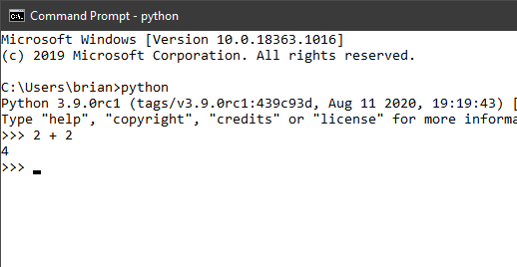
Interactive Mode
Statement entered
Result returned
Next prompt

Slide 18
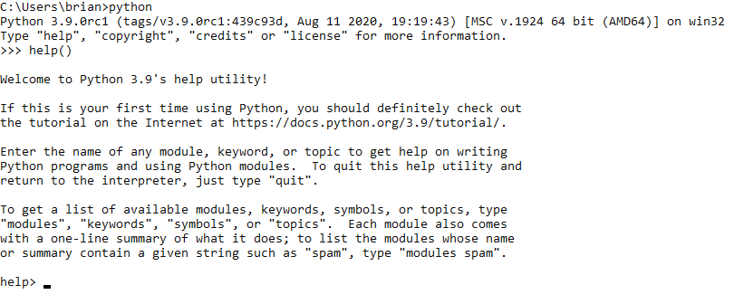
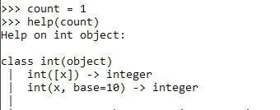
Help
Interactive help
Getting help on a variable
Variable identified as an integer

Slide 19
Python Syntax
Rules for writing code
Some similarities with C, Java, Perl
Python principles
As much as possible, provide one obvious way to do something
Easily readable
Identifies block of code using indentation instead of { } braces
Uses English words instead of punctuation for readability
Everything is an object

Slide 20
Variable Assignment
Variable: Any value that is stored in memory and given a name or an identifier. In your code, you can assign values to these variables.
You don’t have to declare variable type (e.g., integer, float, string).
When you assign a value to a variable, the type is defined automatically.
Example: count = 1
Variable is named count.
Value of 1 is assigned to count.
Python figures out that the data type of 1 is integer, so count will be treated as an integer.
Write variable names in lowercase
Correct: my_variable = 1
Incorrect: MyVariable = 1
Constants
Have values that don’t change.
Differentiated by using uppercase letters.
Example: PI_CONSTANT = 3.14159

Slide 21
Reserved Words
False | elif | lambda
None | else | nonlocal
True | except | not
and | finally | or
as | for | pass
assert | from | raise
break | global | return
class | if | try
continue | import | while
def | in | with
del | is | yield

Slide 22
Functions
Function: A block of code that you can reuse to perform a specific task.
Functions are a vital part of writing efficient code.
Saves you from having to write similar routines repeatedly.
You can define your own functions.
Python provides built-in functions that you can call at any time.
Function names
Followed by open and close parentheses ().
Example: The help() function mentioned earlier.
Must be unique and lowercase, like variable names.
Underscores between words.
Example: read_input_file( )
List of built-in Python functions: https://docs.python.org/3.9/library/functions.html.

Slide 23
Arithmetic Operators
Operator | Definition | Example
+ | Adds operands together. | 2 + 4 will return 6
- | Subtracts right operand from left operand. | 4 – 2 will return 2
* | Multiplies operands together. | 2 * 4 will return 8
/ | Divides left operand by right operand. | 10 / 2 will return 5
% | Divides left operand by right and returns remainder. | 13 % 4 will return 1
** | Performs exponential calculation with left operand as the base and right operand as the exponent. | 2 ** 4 will return 16

Slide 24
Order of Operations
**
* / %
+ -

Slide 25

The print() Function

Slide 26
String Literals
String literal: A value enclosed in single (') or double (") quotation marks, which is treated as text characters.
Enclose within double or single quotation marks.
Use triple quotes to enclose multiple lines.
This results in:
a = "Hello"
b = 'Hello'
a = """Hello,
world!"""
print(a)
Hello,
world!

Slide 27
Escape Codes
Escape Code | Add A …
\\ | Backslash character.
\' | Single quote character.
\" | Double quote character.
\b | Backspace character.
\f | Page break character.
\n | Line break character.
\r | Carriage return character.
\t | Horizontal tab character.
\v | Vertical tab character.
a = "This is a \"string literal.\""
print(a)

Slide 28
Activity: Writing Python Statements
You have set up your environment.
Now you will begin writing Python code.
You will:
Start practicing in the interactive shell, which provides immediate feedback.
Work with programming fundamentals all programs are based on:
Creating variables
Assigning values
Performing operations
Outputting text

Slide 29
Create a Python Application
Topic C

Slide 30
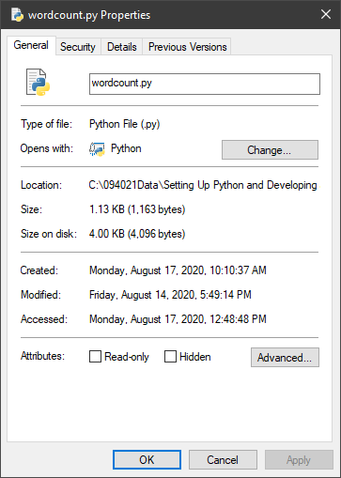
Python Scripts and Files

Slide 31
Comments
# User hasn't yet exited the window.
done = False
done = False # User hasn't yet exited the window.

Slide 32
Program Docstring
"""This program gets a user's input and returns a game board back to them."""
"""This program gets a user's input and returns a game board back to them.
It passes a user's input into a create_board() function that returns
a game board based on the user's difficulty selection."""

Slide 33

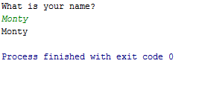
The input() Function
Prompt
User input
Print
name = input("What is your name?\n")
quest = input("What is your quest?\n")
color = input("What is your favorite color?\n")

Slide 34
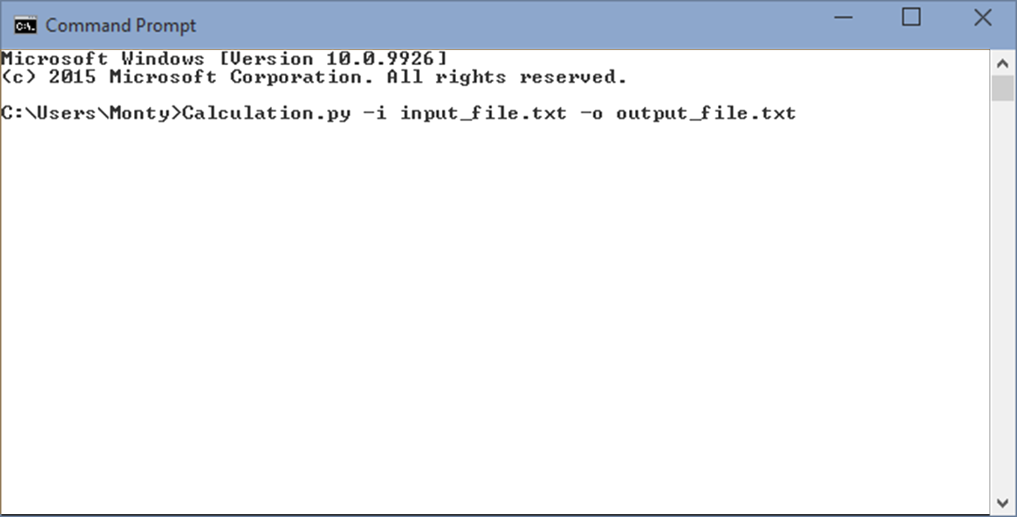
Command Line Arguments
Name of Python script
Input file argument
Output file argument

Slide 35
Activity: Creating a Python Application
You have already:
Reviewed the requirements for the WordCount project.
Created a Python project, including a file to contain the main script.
Now you will start writing Python code to perform some simple input/output tasks.

Slide 36
Prevent Errors
Topic D

Slide 37
Types of Errors in Python
Syntax errors
Logic errors
Exceptions

Slide 38
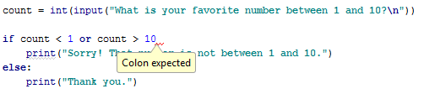
Syntax Error

Slide 39
Logic Error
fav_number = input("What is your favorite number?")
fav_color = input("What is your favorite number?")
print(fav_number)
print(fav_color)

Slide 40

Guidelines for Preventing Errors
Use an IDE with error indicators to detect syntax errors before execution.
Use an IDE with code suggestion or completion to help you resolve syntax errors.
Type carefully, and always remember to indent loops, conditional statements, function definitions, and other objects.
Remember to add a colon at the end of the first line of most of these objects.
Know Python's reserved words list so you don't accidentally try to use one as a variable.
Use docstrings and comments to adequately explain what every block of code should do.
Try to envision how a block of code could affect the whole program if it fails to execute as intended.
Watch for loops that never initiate or terminate.
Thoroughly test larger, more complex programs before releasing them to a wider audience.
During testing, attempt to "break" your code; i.e., test how the code handles unconventional or uncommon input.

Slide 41
Activity: Preventing Errors
In this activity, you will:
Open a slightly different version of wordcount.py that contains some errors.
Use PyCharm features to fix mistakes and get the program running properly.

Slide 42
What about Python is different from the other programming languages you’ve used or have heard of?
When do you think you'll use interactive mode versus running a Python script normally?

